Slide 1
Problem
Presentation
By: Ye Hun Joo and Josh Kuesters

Slide 2
Decision Problem
The decision problem is: Given a complete undirected weighted graph G, find if there is a Hamiltonian cycle and get its total weight
First we have to find all Hamiltonian cycles
Calculate the weight of each cycle
Return the weight of a cycle

Slide 3
Optimization Problem
The optimization problem is: Given a complete undirected weighted graph g, find the shortest Hamiltonian cycle in g and return its weight
Find all the Hamiltonian cycles
Find the weight of each cycle
Compare the weights and return the smallest

Slide 4
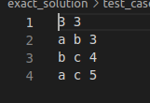
Inputs and Outputs #1

Slide 5
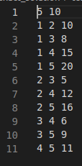
Input and Output #2

Slide 6
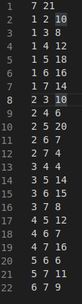
Input and Output #3

Slide 7
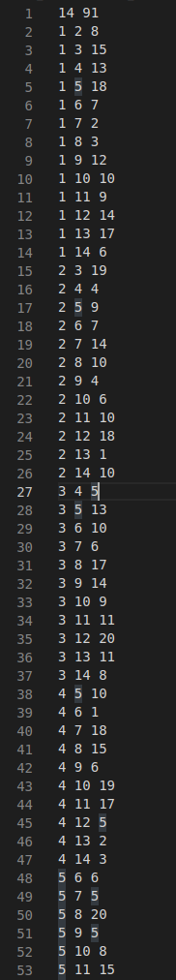
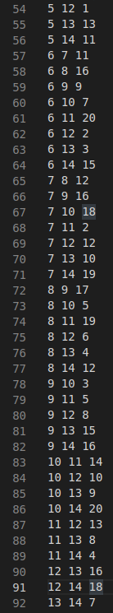
Input and Output #4 (won’t finish in reasonable time)

Slide 8
Sketch of Input #2
1
1
20
20
10
10
8
15
8
15
2
5
2
5
16
16
12
9
12
9
5
11
5
11
3
6
4
3
4
6

Slide 9
Why is it Important?
It is a difficult optimization problem with real world uses:
Train transportation systems
Planning which holes to drill in a circuit board
Flight patterns
As always solving it can lead to solutions for all similar problems

Slide 10
Certifier Process
Given a graph G and a value of k. There exists a path in G that is less than or equal to k.
In order to certify validity:
Check the length of the solution given
If the solution is less than or equals k, then the solution is correct

Slide 11
Reduction
Hamiltonian cycle to Traveling Salesman Problem:
Given a graph G = (V, E), complete G by adding an edge to each pair of vertices that weren’t connected
Next for edges in G’ that are in G, give them a weight of 0 and the other edges 1
b
0
b
1
c
c
1
0
a
0
a
0
1
1
0
d
0
e
d
e
Notes:
1

Slide 12
Reduction cont.
Graph G has a Hamiltonian cycle if and only if there exists a cycle in G’ that:
Passes through each vertex once
Has a total weight of 0
If there is a Hamiltonian cycle in G, then there is a solution to TSP
Therefore, the Hamiltonian cycle can be solved if TSP is solved
b
0
b
0
1
c
c
1
0
0
a
0
a
0
1
1
0
0
d
0
e
d
0
e

Slide 13
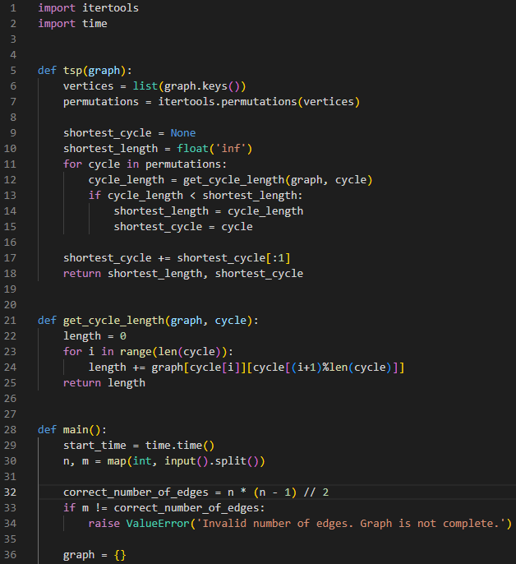
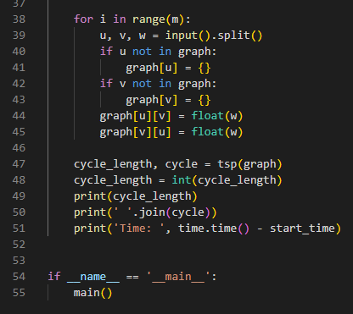
Code explanation
Map out the graph into an adjacency matrix with the weight of the edge at (i,j)
Then uses the itertool permutations to map out all cycles
Next it goes through each cycle and checks the length
It keeps track of the shortest
Returns the shortest length and the cycle

Slide 14
Runtime
The program runs in O(n!)
The most costly part is the iteration of the permutations call
Has a complexity of O(n!)
The get_cycle_length method is the second most costly O(n)
Iterates over all the vertices in the current cycle
The overall time complexity is O(n! * n) but n! dominates over n in large inputs

Slide 15
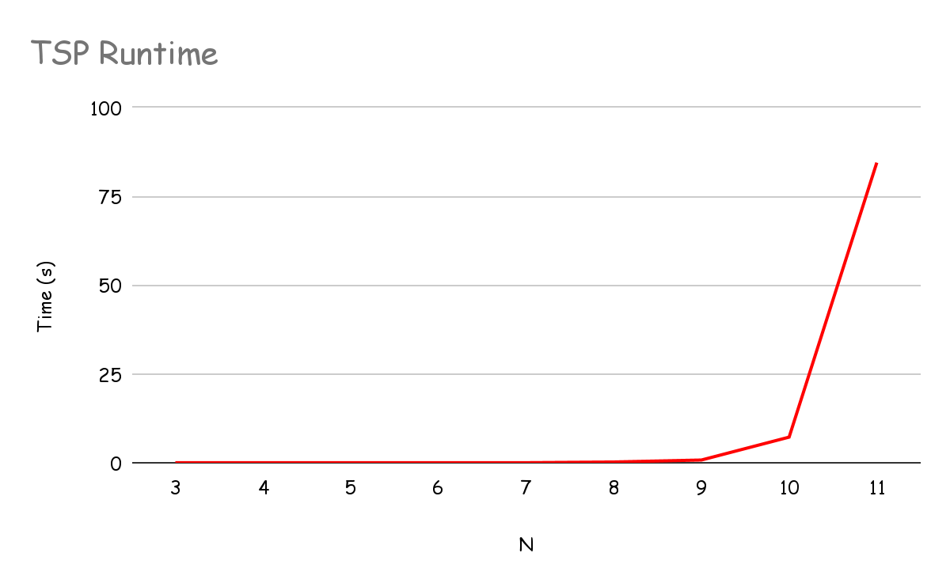
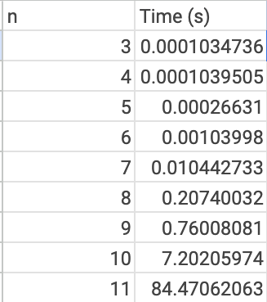
Results

Slide 16
Approximate
Solution
By: Ye Hun Joo and Josh Kuesters

Slide 17
Pseudo-code (greedy)
Read the input n and m
Make sure it is a complete graph
Initialize an empty graph as an adjacency matrix
For each edge in the input
Split it up into u, v, and w
If u isn’t already in the graph then add it as a key with an empty dictionary
Same with v
Add v and w as key-value pairs in the dictionary for u
Add u and w as key-value pairs in the dictionary for v
Call the nearest neighbor method

Slide 18
Pseudo-code cont. (greedy)
Call the nearest neighbor method
Set start vertex as the first key in the graph
Set current vertex as the start
Create a set of unvisited vertices and take out the starting vertex
Create a list
Get the closest vertex with the lowest weight and visit it
Remove from the unvisited set
Set current to the next vertex
Add start vertex to list to make a cycle
Get the length of the cycle and total weight
Return

Slide 19
Comparison

Slide 20
Runtime
The big O runtime in O(n^2), where n is the number of vertices
The main loop iterates over each vertex
For each vertex it iterates over all the neighbors
Therefore, each loop is O(n) which equals O(n^2)

Slide 21
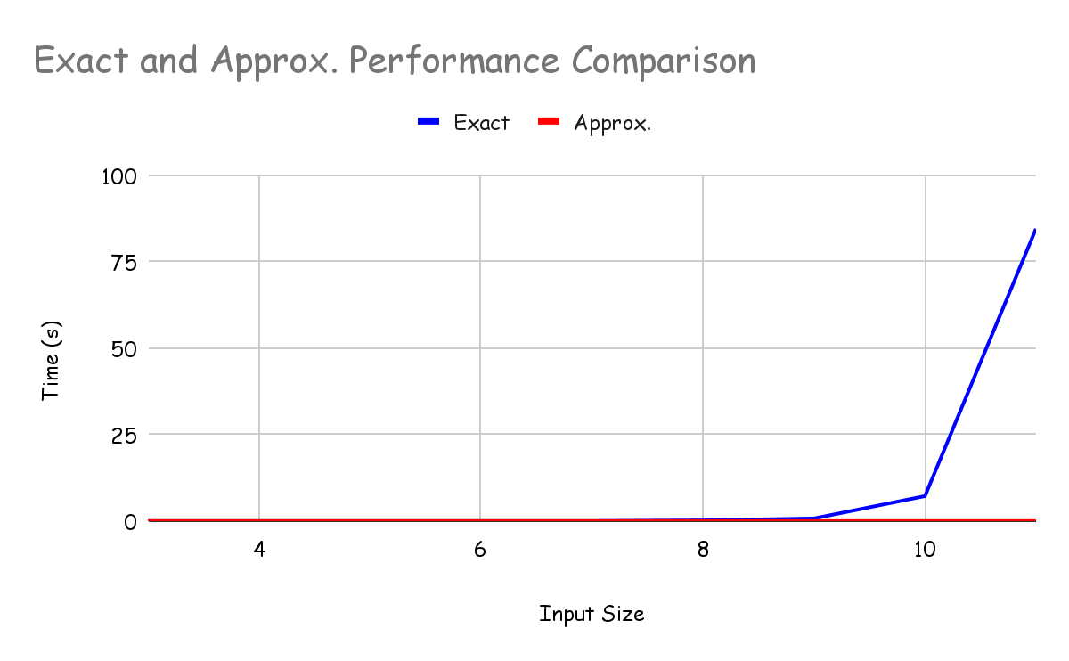
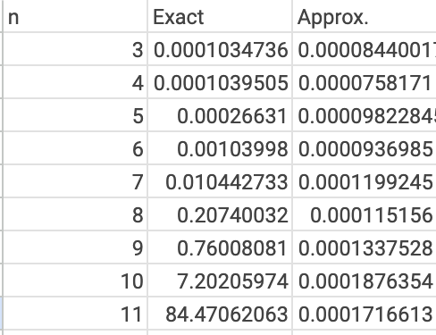
Performance Comparison

